Slide 1
Telematica di Base
Applicazioni P2P

Slide 2
The Peer-to-Peer System Architecture
peer-to-peer is a network architecture where computer resources and services are direct exchanged between computer systems.
In such an architecture, computers that have traditionally been used solely as clients communicate directly among themselves and can act as both clients and servers, assuming whatever role is most efficient for the network.
http://www.peer-to-peerwg.org/whatis/index.html

Slide 3
Peer-to-peer (P2P) computing or networking is a distributed application architecture that partitions tasks or work loads between peers. Peers are equally privileged, equipotent participants in the application. They are said to form a peer-to-peer network of nodes.
Peers make a portion of their resources, such as processing power, disk storage or network bandwidth, directly available to other network participants, without the need for central coordination by servers or stable hosts.

Slide 4
Definition of P2P
“P2P is a way of structuring distributed applications such that the individual nodes have symmetric roles. Rather than being divided into clients and servers each with quite distinct roles, in P2P applications a node may act as both a client and a server.”
Excerpt from the Charter of Peer-to-Peer research Group,
IETF/IRTF, June 24, 2003

Slide 5
P2P
In the peer-to-peer paradigm, the participating processes play equal roles, with equivalent capabilities and responsibilities (hence the term “peer”).
Each participant may issue a request to another participant and receive a response.

Slide 6
P2P
The peer-to-peer paradigm is appropriate for applications such as instant messaging, peer-to-peer file transfers, video conferencing, and collaborative work.

Slide 7
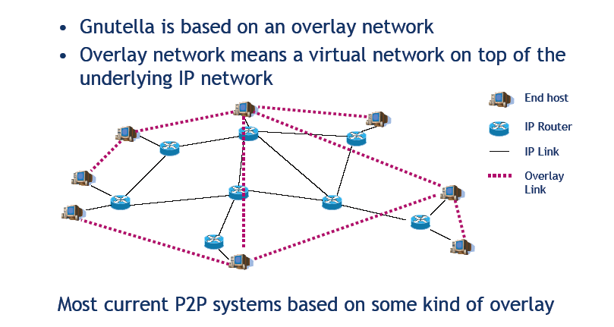

Slide 8
The nodes in the overlay network form a subset of the nodes in the physical network.
Data is still exchanged directly over the underlying TCP/IP network, but at the application layer peers are able to communicate with each other directly, via the logical overlay links (each of which corresponds to a path through the underlying physical network).
The choice of which nodes belong to the overly network depends from the particular method used for store and lookup resources.
Overlays make the P2P system independent from the physical network topology.

Slide 9
Peer- to -peer basics operations
BOOT: input into the peer to peer infrastructure
LOOKUP: resource localization
FILE SHARING

Slide 10
Peer to Peer classification
(lookup techniques)
Peer to Peer infrastructure
centralized approach
decentralized approach

Slide 11
Centralized approach
Napster
Sharing of MP3 music files
In 1993 record companies prosecute Napster (copy right)
In 2002 Napster ceased operations. («Napster was here»)
In 2011 it becames on online paid music store
Notes:
Thousand of people were, through napster, making thousand of copyrighted songs and neither the music industry nor the artists got qny money in return from those copies (This type of piracy is still happening now,through sites other Napster.
Napster defense was that the files where personal files that people maintened on their own machines and then Napster was not responsible

Slide 12


P2P:Centralized Directory
NAPSTER
The peers establishe a connection to a centralized server
  - IP address
  - Shared information
2) Alice produces a query to find “Hey Jude”
3) Alice downloads the file from Bob
Bob
centralized
directory server
1
peers
1
1
3
2
1
Alice

Slide 13
Napster behaviour
When a node enters the infrastructure, using a Napster client, its identity and a list of files stored in its disk memory are loaded in the central server.
When a node looks for a particular file it sends a query to the central server.
Depending on the obtained results the node connects to another node to download the require file

Slide 14
Discussion
Two aspects
distributed
file transfer
b) centralized information
Single failure point
limited performance
Copyright ….

Slide 15
Decentralized approach
No structured
Structured

Slide 16
Unstructured networks
Unstructured peer-to-peer networks do not impose a particular structure on the overlay network by design, but rather are formed by nodes that randomly form connections to each other. (Gnutella, Kazaa)
Because there is no structure globally imposed upon them, unstructured networks are easy to build. Also, because the role of all peers in the network is the same, unstructured networks are highly robust ( large numbers of peers can frequently joining and leaving the network).

Slide 17
When a peer wants to find a piece of data in the network, the search query must be flooded through the network to find as many peers as possible that share the data.
Flooding causes a very high amount of signaling traffic in the network, uses more CPU/memory (by requiring every peer to process all search queries), and does not ensure that search queries will always be resolved.
Furthermore, since there is no correlation between a peer and the content managed by it, there is no guarantee that flooding will find a peer that has the desired data.

Slide 18
Gnutella
The first decentralized peer-to-peer network (2000).
The name is a portmanteau of GNU and Nutella. Supposedly, Frankel and Pepper ate a lot of Nutella working on the original project, and intended to license their finished program under the GNU General Public License

Slide 19
Gnutella
It is one of the first systems wich does not depend from a centralized directory.
Each node which implements Gnutella protocol knows a set of different nodes which implement the same protocol.
Query message. Sent by a node to a close node with the specification of the request object.
Query response. If one of the close nodes owns the object replays giving IP and port number.

Slide 20
If the node that received the request is not able to satisfy it, send the Query message to each of the own close nodes belonging to the overlay network and the process repeats..
QID (query identifier). Each Query message contains QID, but does not contain the identity of the node of the original message.
Each node manages a directory of the Query messages recently received, storing the QID of the close node which sent the message.
Every time that a node receives a Query Response from a close node, send the response to the close node that sent the request.In this way the response flows to the source node without none of the intermediate nods knows the source node.

Slide 21
Gnutella
File transfer:
HTTP GET
Query
QueryHit
Query
Query
QueryHit
Query
QueryHit
Query

Slide 22
Gnutella:innovative features
overlay network
Peers are nodes
Connections among peers
Virtual network
bootstrap node
a connecting peer (peer join) must find a peer in the overlay network
vantages
There is’nt a centralized directory
  The localization service is distributed among the peers
disavantages
Query flooding
  Restriction of the area of the query

Slide 23
KaZaA
peer structure
  Peer = group leader o it is associated to a group leader.
  TCP with Peer -- Group leader
  TCP cons among pairs of group leader.
Group leaders: is a particular type of centralized directory for the peers associated to the group

Slide 24
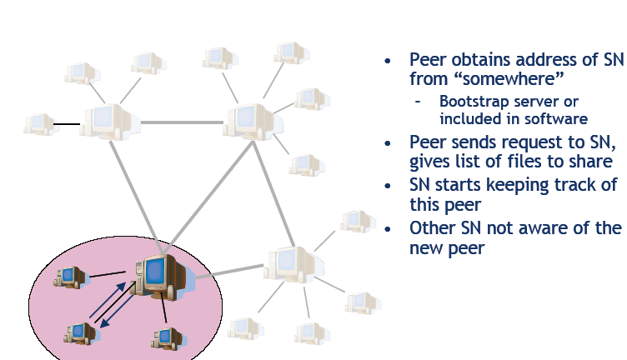

Slide 25
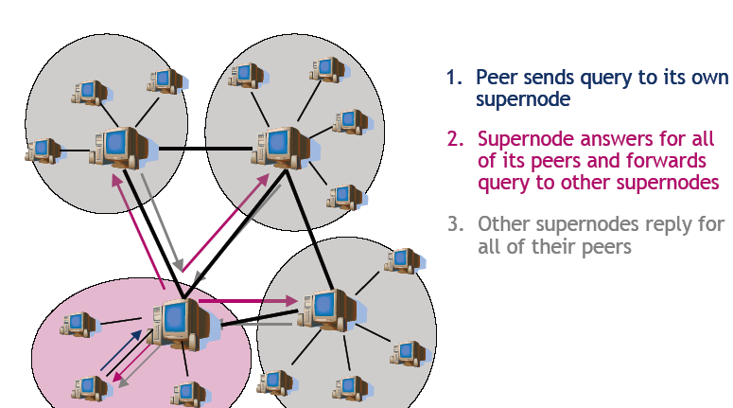

Slide 26
These systems differed in how they located the data offered by their peers.
Napster, required a central index server: each node, upon joining, would send a list of locally held files to the server, which would perform searches and refer the querier to the nodes that held the results. This central component left the system vulnerable to attacks and lawsuits.
Gnutella and similar networks moved to a flooding query model – in essence, each search would result in a message being broadcast to every other machine in the network. While avoiding a single point of failure, this method was significantly less efficient than Napster.

Slide 27
Structured networks
In structured peer-to-peer networks the overlay is organized into a specific topology, and the protocol ensures that any node can efficiently search the network for a file/resource, even if the resource is extremely rare.
Distributed hash tables (DHT) use a more structured key-based routing in order to attain both the decentralization of Gnutella, and the efficiency and guaranteed results of Napster.
Nodes and keys are assigned a m-bit identifier using consistent hashing. Both keys and nodes are uniformely distributed in the identifier space with a negligible possibility of collision.

Slide 28
Hash Functions
A hash value is generated by a function H of the form
h=H(M)
where M is a variable-length message and H(M) is the fixed-length hash value.
The purpose of a hash function is to produce a “ digest” of a file, message or other block of data.

Slide 29
Requirements for a hash function:
H can be applied to a block of data of any size.
H produces a fixed -length output.
H(x) is relatively easy to compute for any given x, making both hardware and software implementations practical.
For any given code h, it is computationally infeasible to find x such that H(x)=h (one- way property)
-

Slide 30
It is computationally infeasible to find any pair (x,y) such that H(x)= H(Y). This is sometimes referred to as strong collision resistance
The H(x) values are uniformely distributed in the identifier space with a negligible possibility of collision. (consistent hashing)

Slide 31
Chord Algorithm
Nodes and keys are assigned a m-bit identifier using consistent hashing.
Nodes and keys are arranged in a identifier circle that has at most 2^{m} nodes, ranging from 0 to 2^{m}- 1 (m should be large enough to avoid collision).
Each node has a successor and a predecessor. The successor to a node is the next node in the identifier circle in a clockwise direction. The predecessor is counter- clockwise.
If there is a node for each possible ID (node identifier), the successor of node 0 is 1 and the predecessor of node 0 is 2^{m}-1 However, normally there are holes in the sequence.

Slide 32
Ex: the successor of node 153 may be node 167 (nodes from 154 to 166 do not exist). The predessor of node 167 will be node 153.
The concept of successor can be used for keys as well. The successor node of a key k is the first node whose ID equals to k or follows k in the identifier circle, denoted by successor (k).
If i₁ and i₂ are two adjacent IDs, the node with ID i₂ is the owner of all the keys included between i₁ and i_{2 .}
The key requested or to be stored is sent node by node in the overlay network. In each node is contained the successor of the node.
Every key is assigned (stored at) to its successor node, so looking up a key k is to query successor (k).

Slide 33
P2P Communications: IM
Istant Messaging
  central server with the buddy list
  User connects the server
chatting among peers
centralized server
  Solution like Napster

Slide 34
P2P Communications
Skype: Internet Telephony Software
  It allows to use internet for telephone calls.
    telephonic networks reached via internet
Architecture analogous to KaZaA

Slide 35
Skype
Proprietary application: technical description is not available
Some informations:
  Central server for “billing”
  GroupLeader as KaZaA
    Similar features
  directory service for the on-line users

Slide 36
Email
outgoing
message queue
user mailbox
Three components:
user agent
mail server
simple mail transfer protocol: smtp
User Agent
features: reading, writing and sending mail
Eudora, Outlook, Pine, MacMail
Messages are stored in the server
user
agent
mail
server
user
agent
SMTP
mail
server
user
agent
SMTP
SMTP
mail
server
user
agent
user
agent
user
agent

Slide 37
E-Mail: mail server
user
agent
Mail Server
mailbox contains messages not i msg non still read by the users
Smtp: communication protocol among the mail servers
mail
server
user
agent
SMTP
mail
server
user
agent
SMTP
SMTP
mail
server
user
agent
user
agent
user
agent

Slide 38
Alice e Bob
1) Alice sends a e-mail to bob@school.edu
2) The message is inserted in the queue of the mail server
3) SMTP (client side) defines a connection TCP with the Bob mail server
4) SMTP (client side) sends the Alice message on the TCP connection
5)The mailserver of Bob stores the message in the mailbox of Bob
6) Bob read the message using its user agent (POP3 o IMAP)
1
mail
server
mail
server
user
agent
user
agent
2
3
6
4
5

