Slide 1
OPERATING
SYSTEMS OVERVIEW

Slide 2
Contents
O.S.Functions
The Evolution of O.S.
Characteristics of O.S.
Basic hardware elements

Slide 3
Contents
O.S.Components
System calls
O.S.Structure

Slide 4
USER 1
USER 2
USER 3
USER n
compiler
text editor
interpreter
database system
operating system
computer hardware

Slide 5
Programming system components
compilers
loader
linker
comand interpreter (shell)
…

Slide 6
O.S. purposes
to make a computer more convenient and easier to use
to allow more efficient operations of the whole computer system

Slide 7
To simplify the program development
The O.S. masks the details of the hardware from the programmer and provides the programmer with a convenient interface for using system resources (system calls)

Slide 8
To simplify the program development
Definition of an extended (virtual) machine

Slide 9
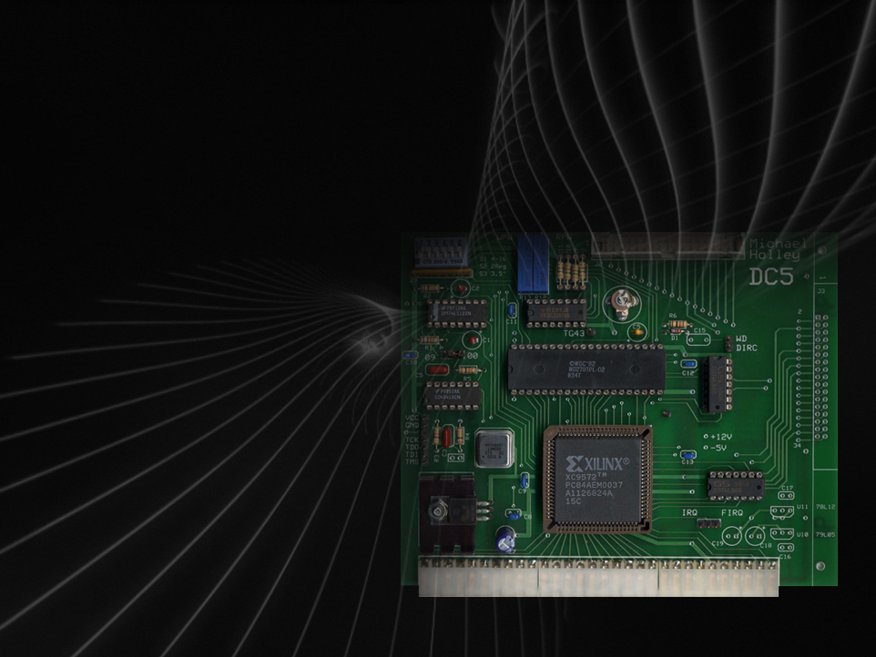
VIRTUAL MACHINE
ES: DISK CONTROLLER

Slide 10
commands: read, write, head motion, ecc…
parameters: sector address, number of sectors for each track, ecc…
state and error conditions

Slide 11
Hardware resource allocation
Access to system resources must be controlled and conflicts for resource contention resolved

Slide 12
Hardware resource allocation
Any user should be provided with required resources, by following suitable policies

Slide 13
The details for the management of hardware resources must be hidden to users

Slide 14
System calls provide the interface between the application programs and the O.S.

Slide 15
THE EVOLUTION OF O.S.

Slide 16
Serial processing
No O.S.
Control by console
Scheduling
Setup time

Slide 17
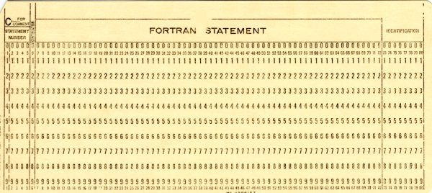

Slide 18
Simple batch systems
Monitor
Resident in main memory
Control of the program execution
“batch” solution

Slide 19
Uniprogramming systems
Only one program in main memory
Machine time alternates between execution of user programs and monitor (OS)

Slide 20
Uniprogramming systems
operating system
main memory organization in a batch uni-programming
system
user program

Slide 21
Uniprogramming systems
Hardware and software resources of the computer system are dedicated to only one program (monouser system)

Slide 22
Uniprogramming systems
low CPU utilization
CPU utilization
I/O waiting
t

Slide 23
Hardware characteristics
Memory protection
Timer
Privileged instructions
Interrupts

Slide 24
Spooling (simultaneous peripheral operation on-line)
disk
card
reader
printer
CPU and memory

Slide 25
Multiprogrammed Batch Systems
O.S.
job 1
job 2
job 3
A multiprogramming system with three jobs in memory

Slide 26
Multiprogrammed Batch Systems
Increase of resource utilization
CPU utilization
I/O waiting
job 1
job 2
t

Slide 27
Multiprogrammed Systems
O.S. are more sophisticated
Algorithms for resource management (CPU, memory, I/O)

Slide 28
Multiprogrammed Systems
O.S. are more sophisticated
Protection of the environments of different jobs

Slide 29
Multiprogrammed Systems
Scheduling algorithms
Job mix
CPU-bound job
I/O-bound job

Slide 30
Multiprogrammed Batch Systems
Example
OS/36O working on IBM 36O e 37O series

Slide 31
Multiprogrammed Batch Systems
High efficiency in resource utilization
Users cannot directly interact with the O.S.
Large response time

Slide 32
Interactive systems
direct communication between the user and the system

Slide 33
Interactive systems
the user gives instruction to the O.S. directly, by using either a keyboard or a mouse and waits for immediate results

Slide 34
Time-sharing systems
Logical extension of multiprogramming
Multiple users simultaneously access the system through terminals

Slide 35
Time-sharing systems
Logical extension of multiprogramming
The O.S. interleaves the execution of each user program in a short burst or quantum of computation

Slide 36
Time-sharing systems
At the end of the quantum (or during the quantum, if the job executes an I/O instruction) the CPU is switched to a different job.

Slide 37
Time-sharing systems
One of the first developed time sharing O.S. was the CTSS (Compatible Time Serie System), MIT years 6O’
MULTICS, UNIX, …

Slide 38
Overhead
CPU utilization
I/O waiting
overhead
job 1
job 2
t

